Slide 1

Presentation on FOOD FOR NEEDY
Team members :-
Niru Kumari Mishra (740325)
Rabin Phaiju (740329)
Rodip Duwal (740334)
Roshan Dumaru (740335)

Slide 2
Content
Introduction
Statement of Problems
Objectives
Scope
Literature Review
Methodology
Result

Slide 3
Introduction
Surplus Food
Food For Needy, a platform that allows to share information between donor, sponsor and distributor.
Shows what donor offers
Shows where the program will be held by sponser
Provide a platform to become a volunter

Slide 4
Statement of Problems
No such effective platform
No proper display of food item's details in user/receiver login
No proper display of schedule program by sponser

Slide 5

Objectives
To provide a platform that:
a schedule information what a donor/sponser offers
a receive can get

Slide 6
Scope
Build a platform to link food donor and receiver.
Host in web.
Provide a schedule information

Slide 7
Literature Review
Related projects (FoodRescue, groliste, Foodtank,Food for life etc.)
Issue such as
No links between donor and receiver
No Scheduled information were maintained.

Slide 8
Methodology
Tools & Platform
Sublime
JS
PHP
HTML
Bootstrap
Apache Server

Slide 9
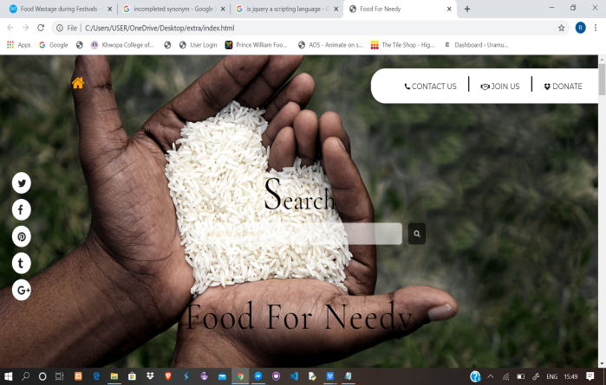
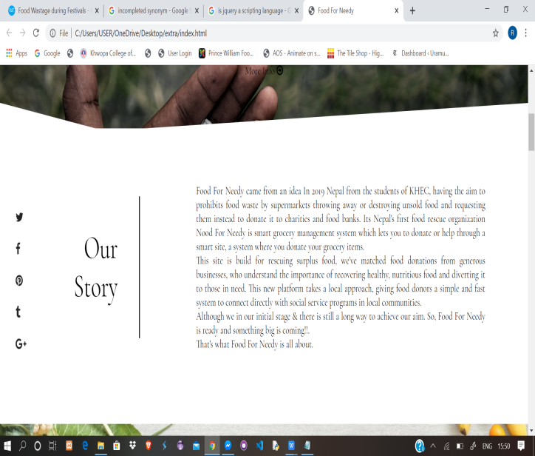
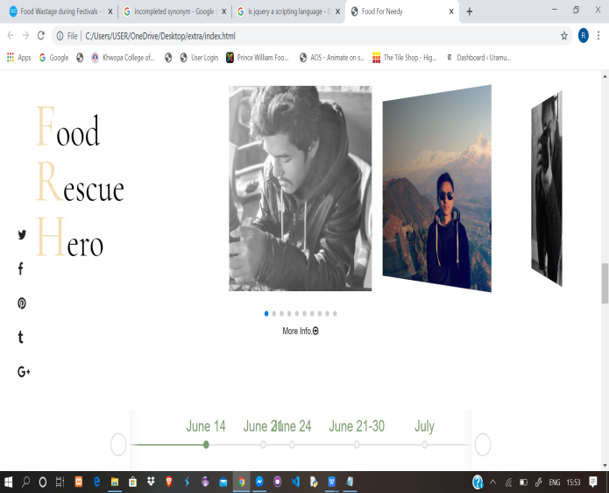
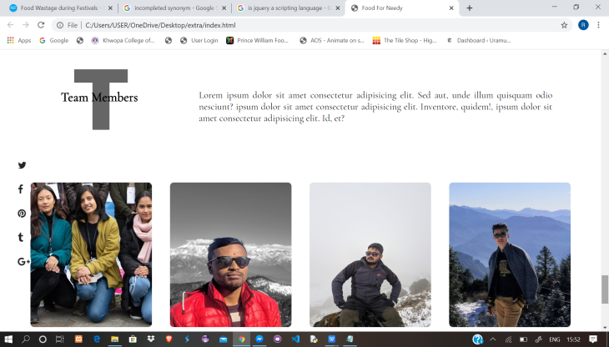
RESULT
Task completed:
Front end:

Slide 10
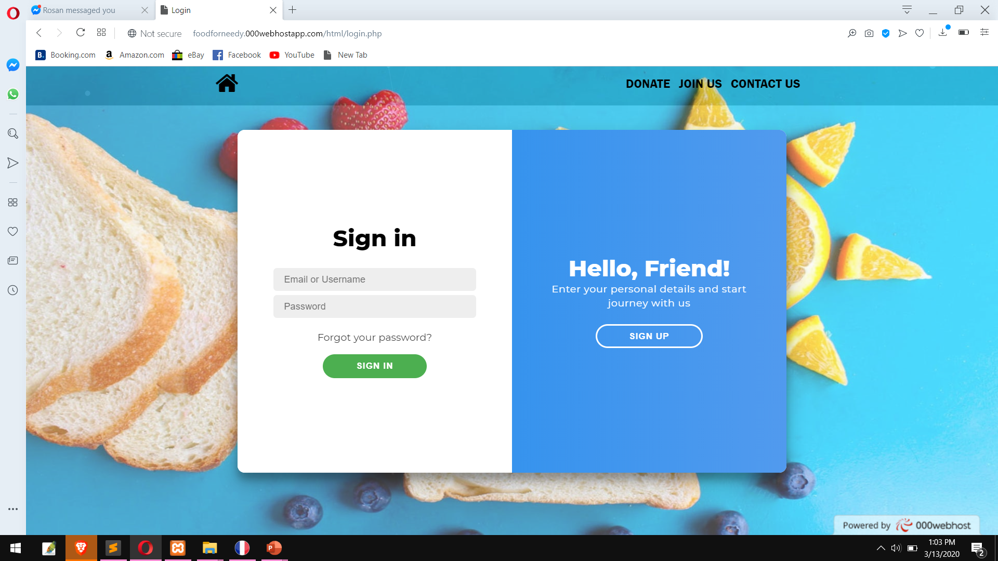
RESULT
Login Page:

Slide 11
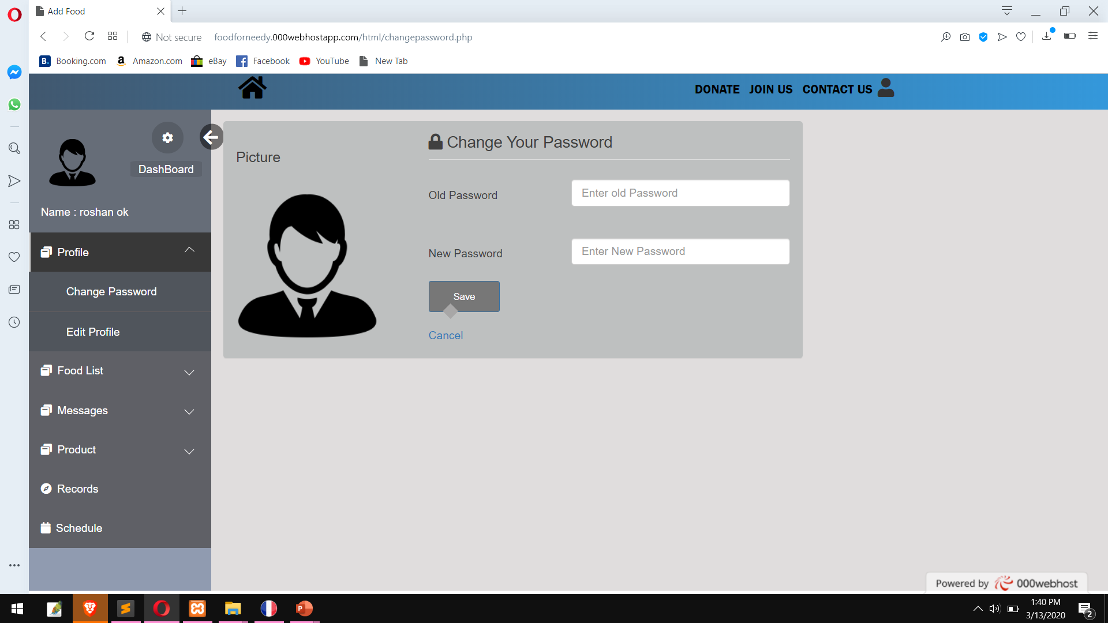
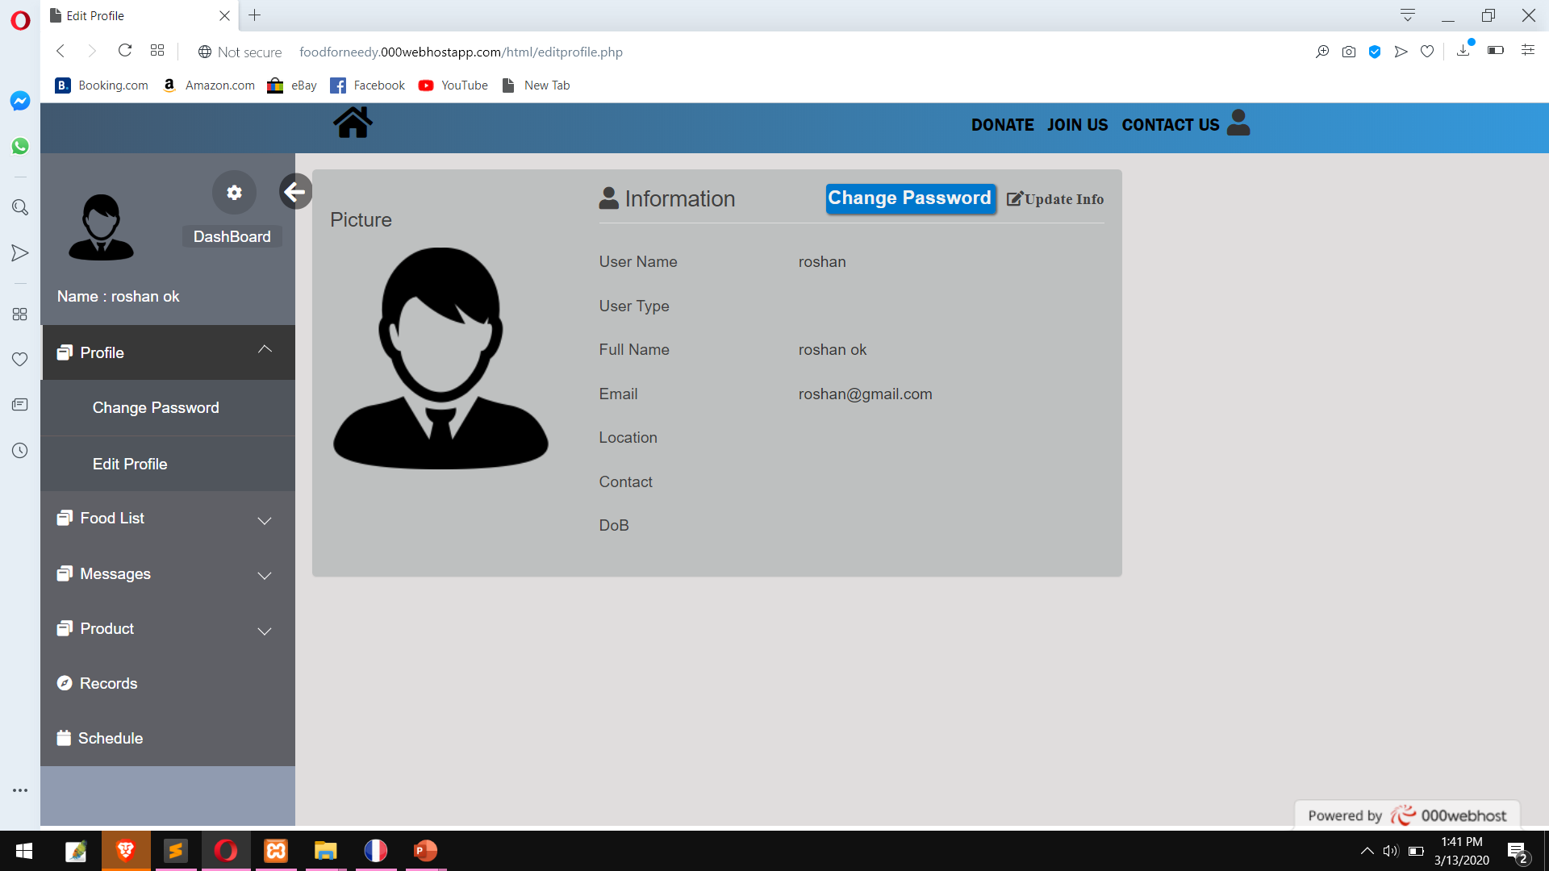
RESULT
Editing User Details:

Slide 12
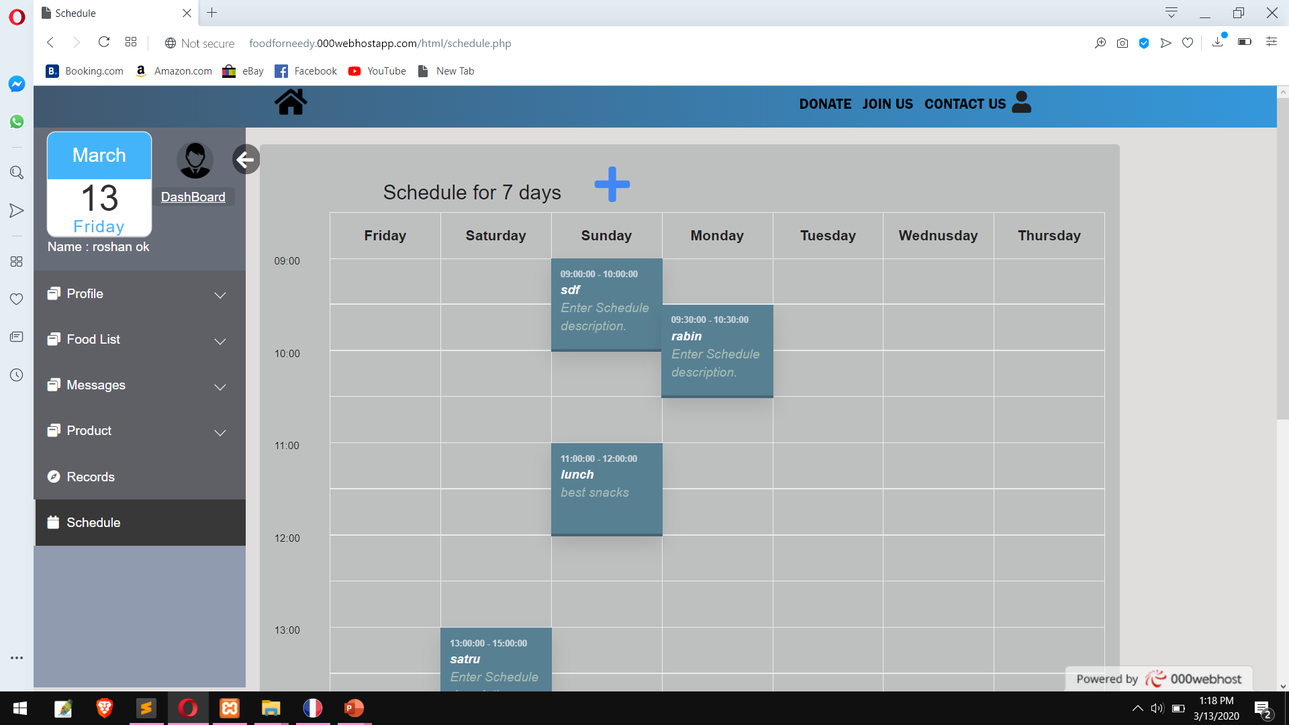
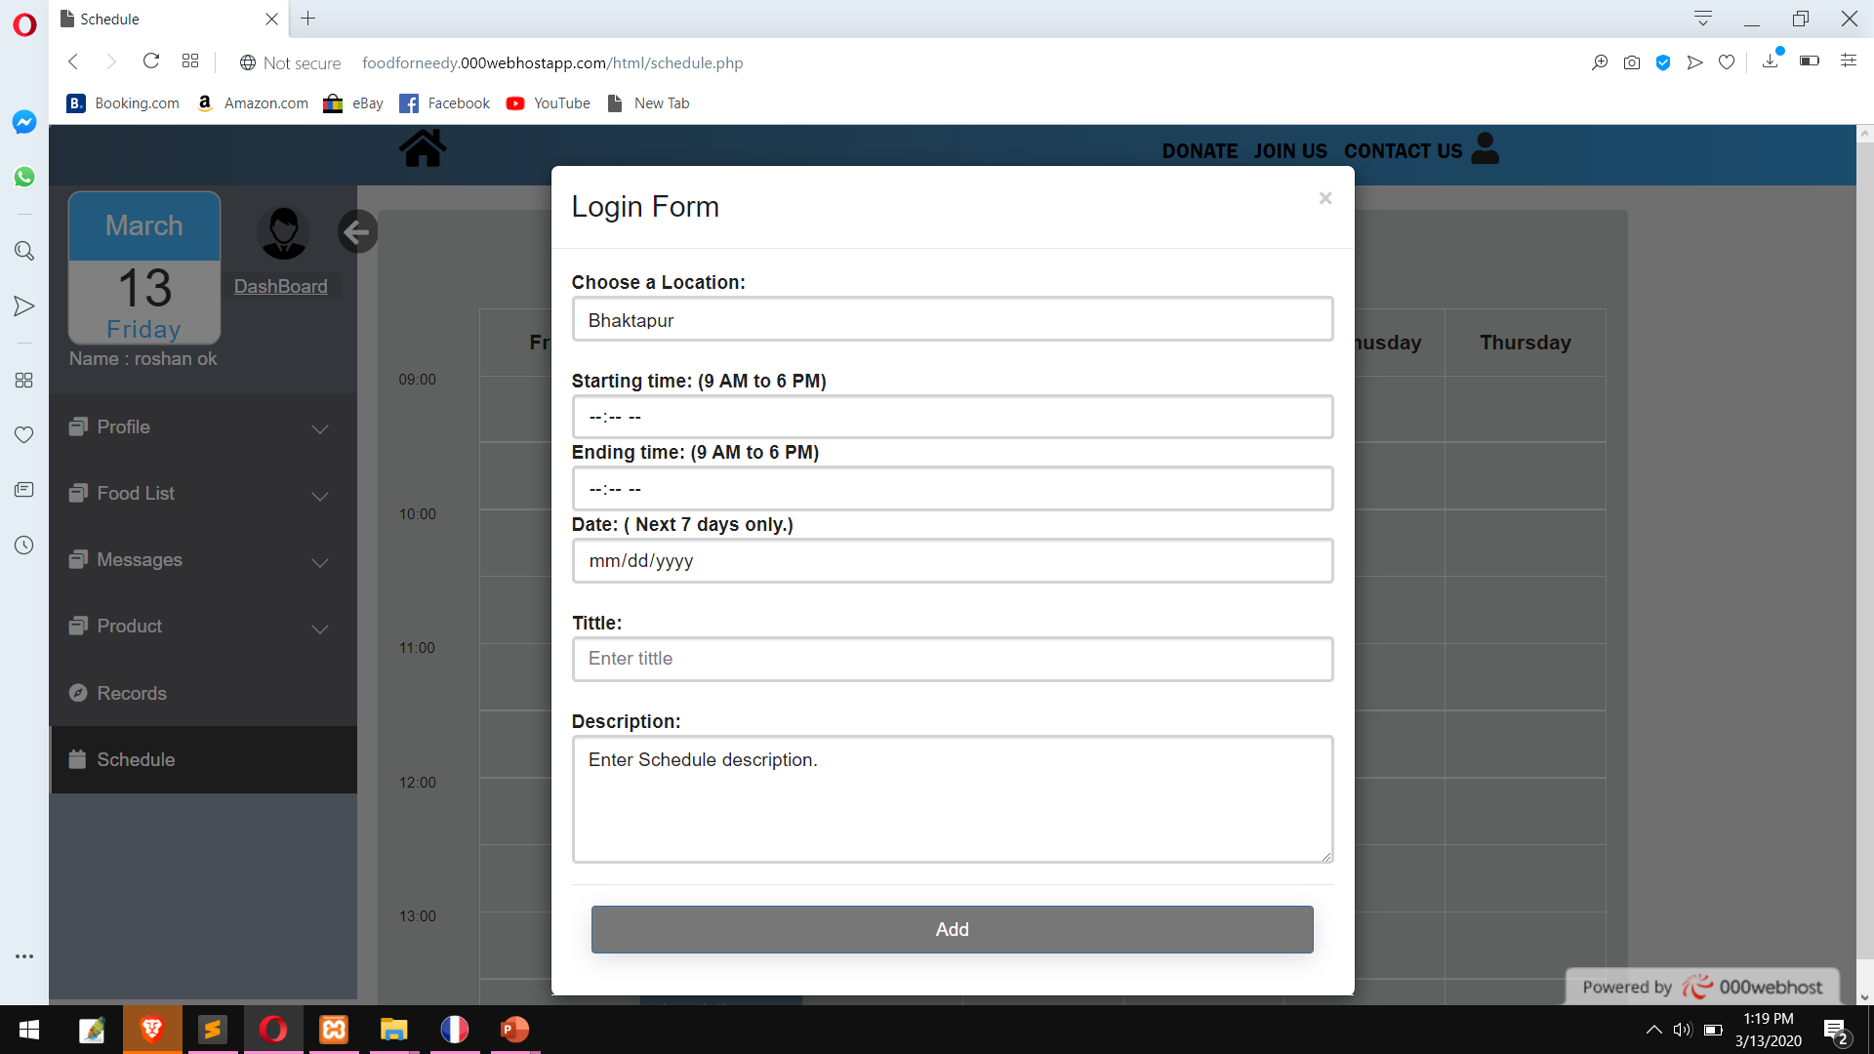
RESULT
Scheduling Page:

Slide 13
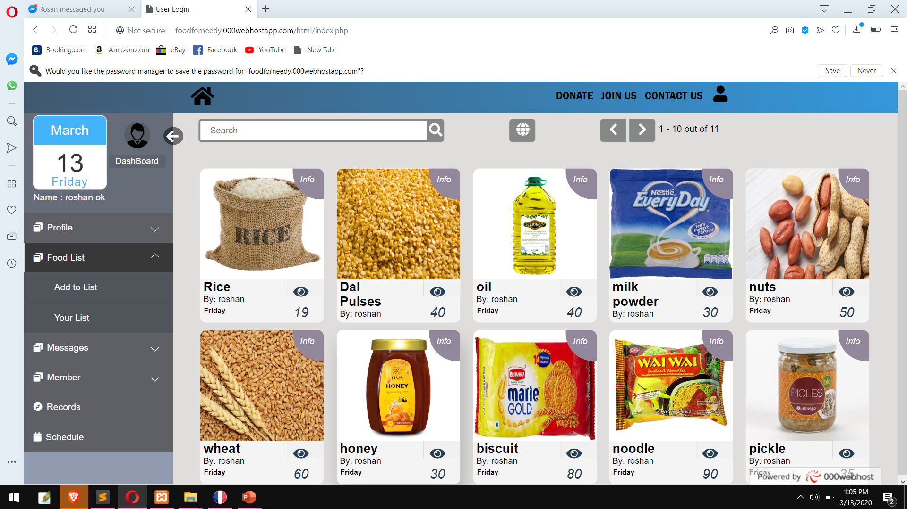
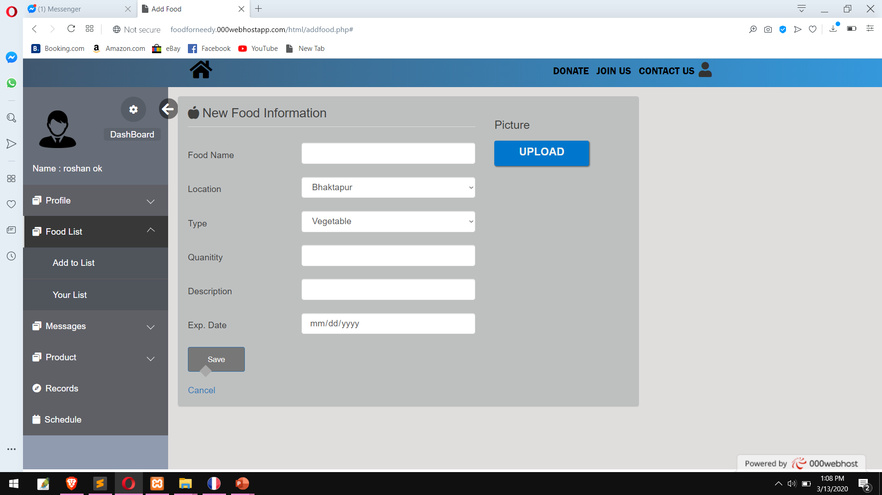
RESULT
Donation Page:

Slide 14
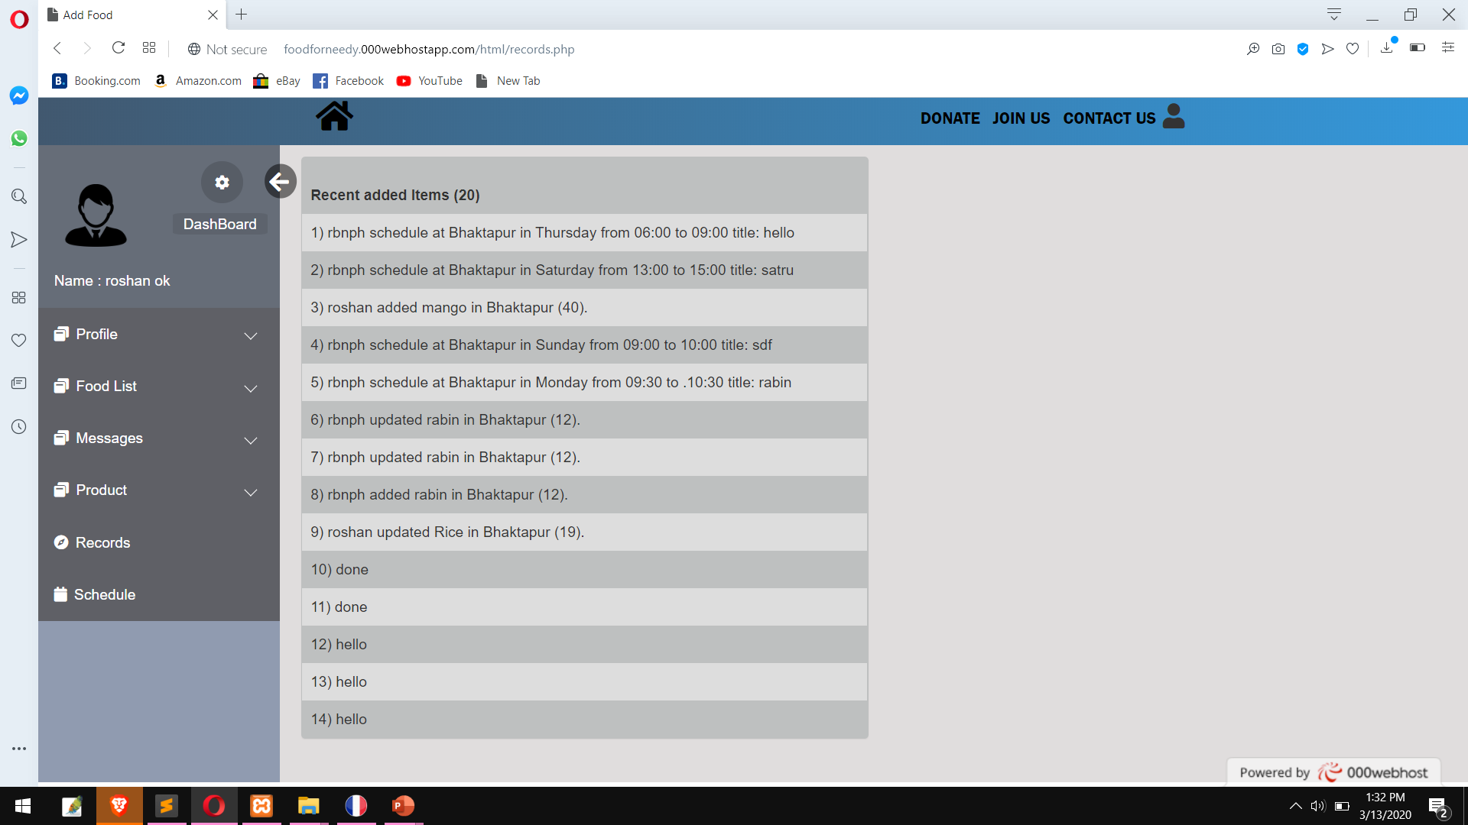
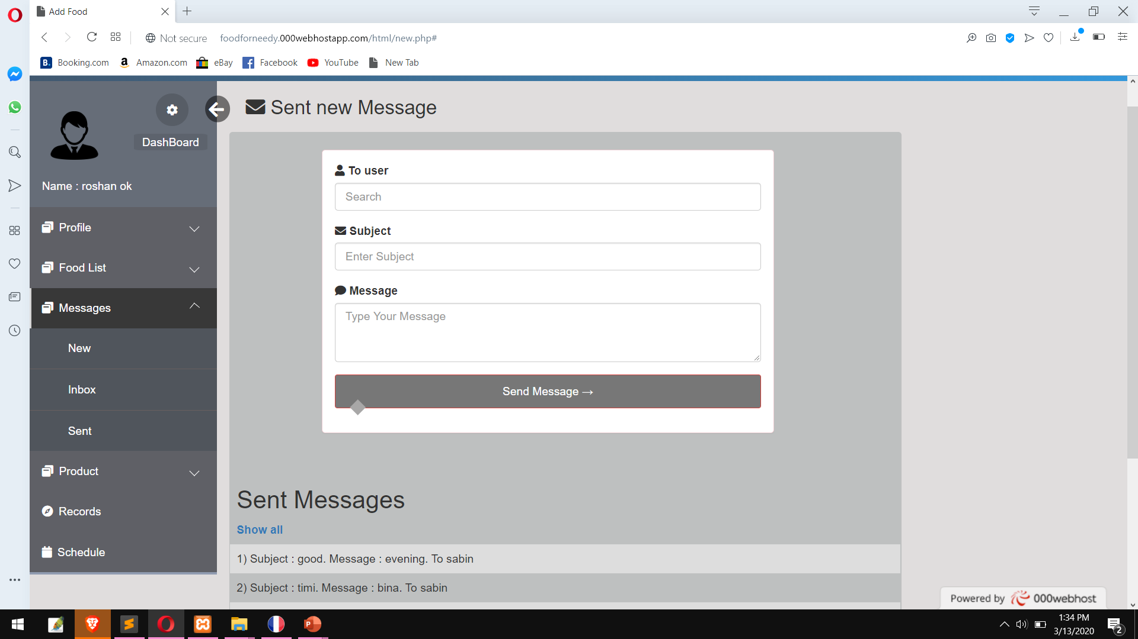
RESULT
Record & Message Page:

Slide 15

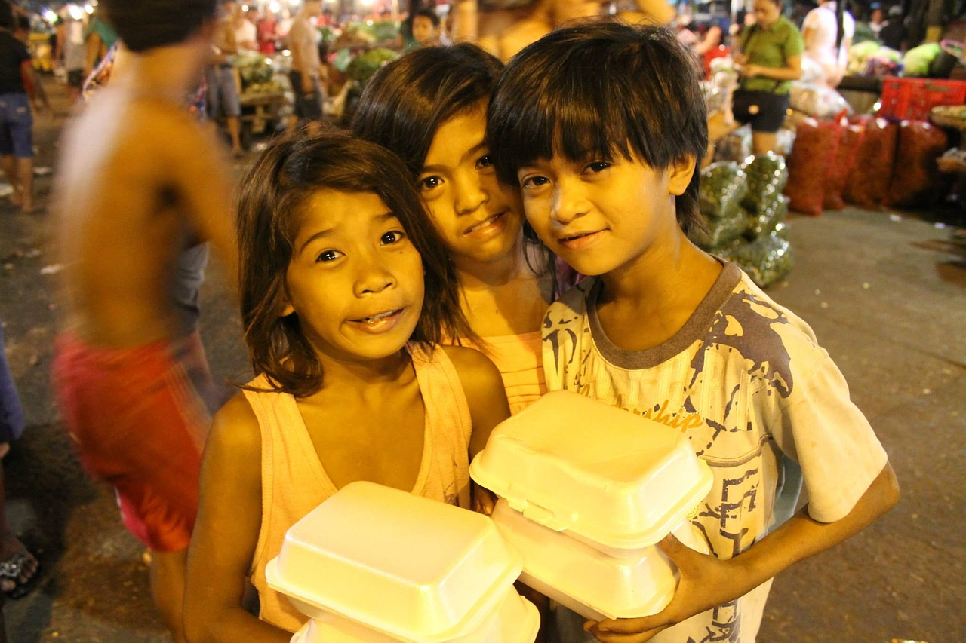
Any Queries !!!

Slide 16
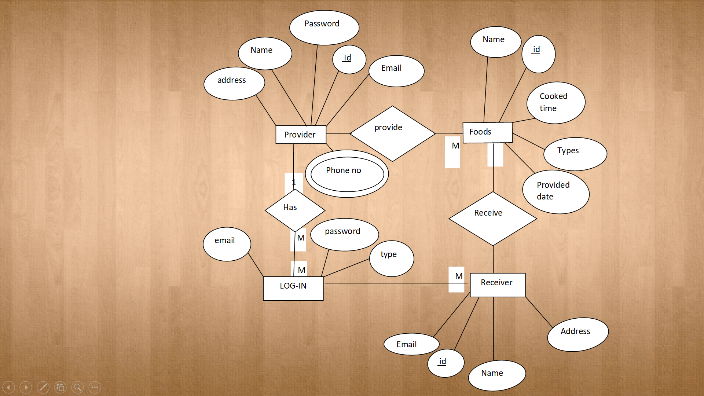
E-R Diagram

Slide 17
Work Breakdown Structure
S.N | Week JobDescription | 1stWeek | 2ndWeek | 3rdWeek | 4thWeek | 5thWeek | 6thWeek | 7thWeek | 8thWeek
1. | Problem Identification
2. | Analysis
3. | Design
4. | Coding
5. | Implementation and testing
6. | Documentation

